Slide 1
Making connections
An image based tour of my interactions and critical incidents across my professional learning network as I look to deepen my knowledge around the digital literacy divide by connecting online (Richardson & Mancabelli, 2011).

Slide 2
First contact
Starting from the known…a small critical incident amongst close ties in a like-minded community formed by the group – net, the community of practice, that are my university peers (Dron & Anderson, 2014, p. 80).

Slide 3
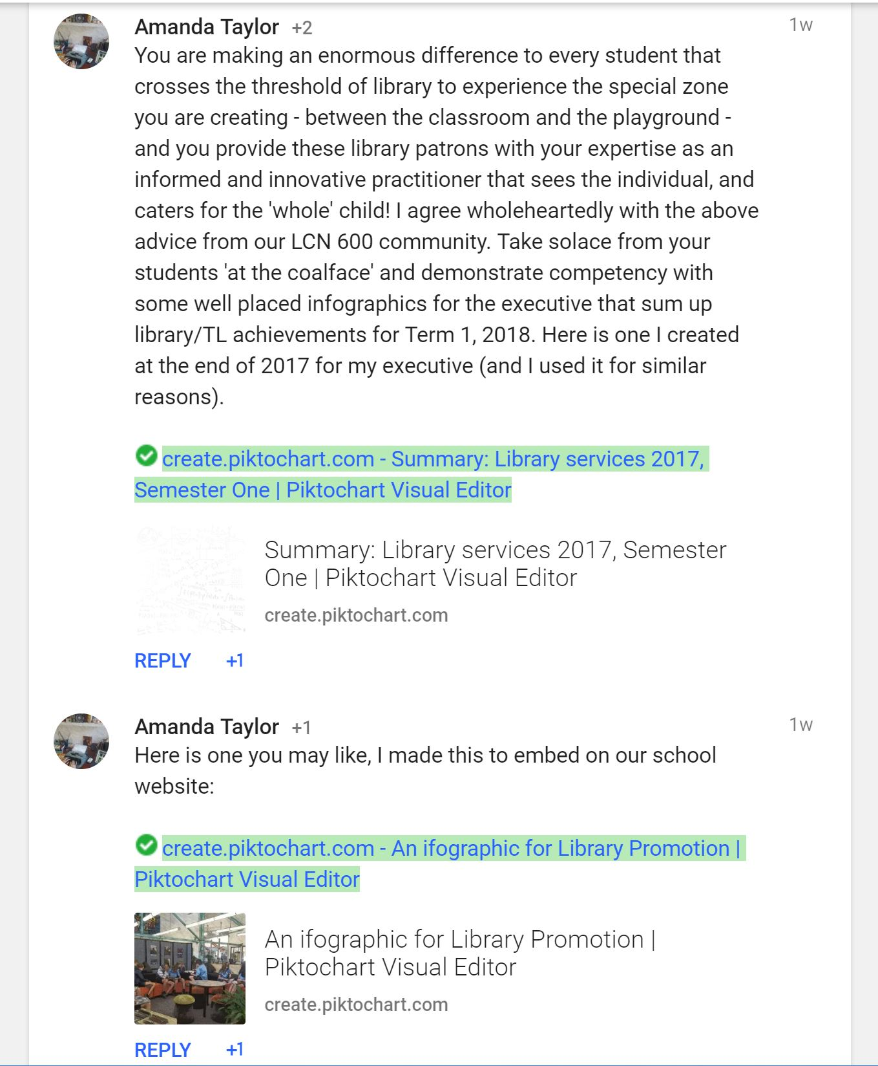
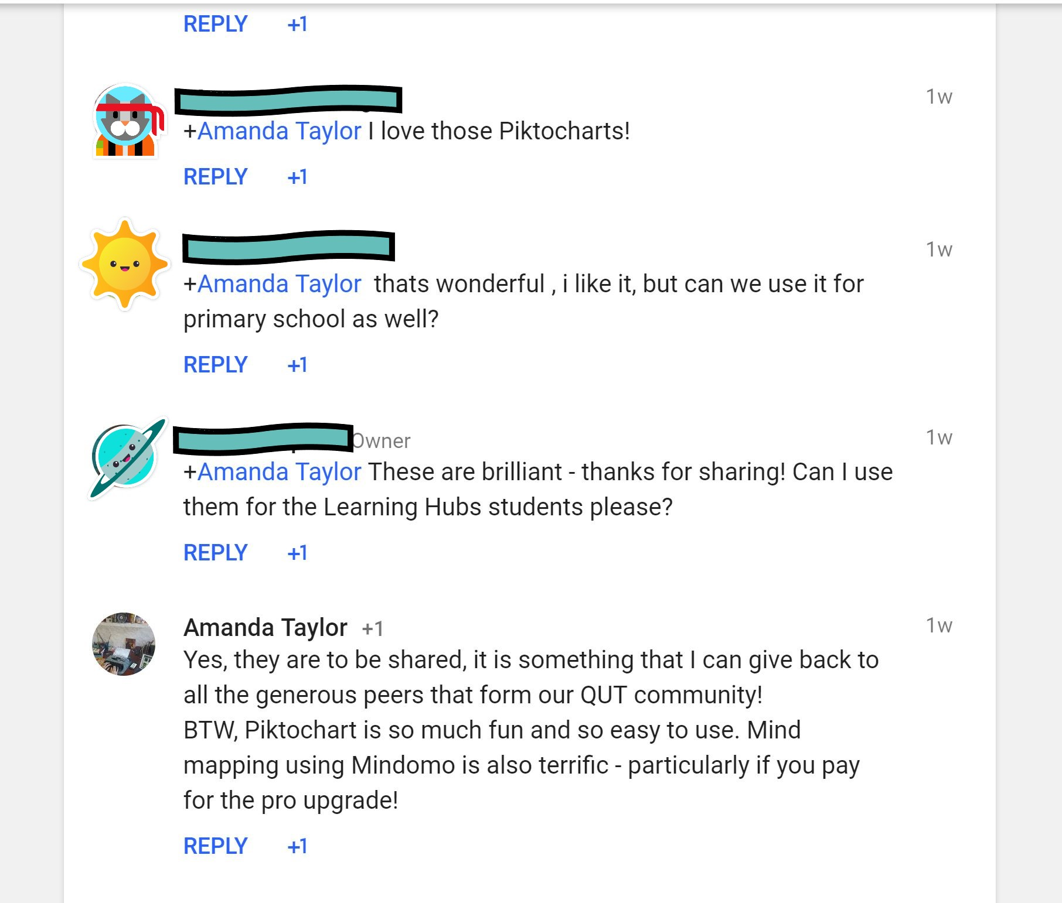
my Google+ community formed by University colleagues
28/03/2018
28/03/2018
07/04/2018
The replies form my first critical incident. I have people connecting with me and appreciating the infographic I created and freely shared (using CC by NC SA) within the close knit group that are my community of practice. This CoP is formed via my participation in a university course (Dron & Anderson, 2014).

Slide 4
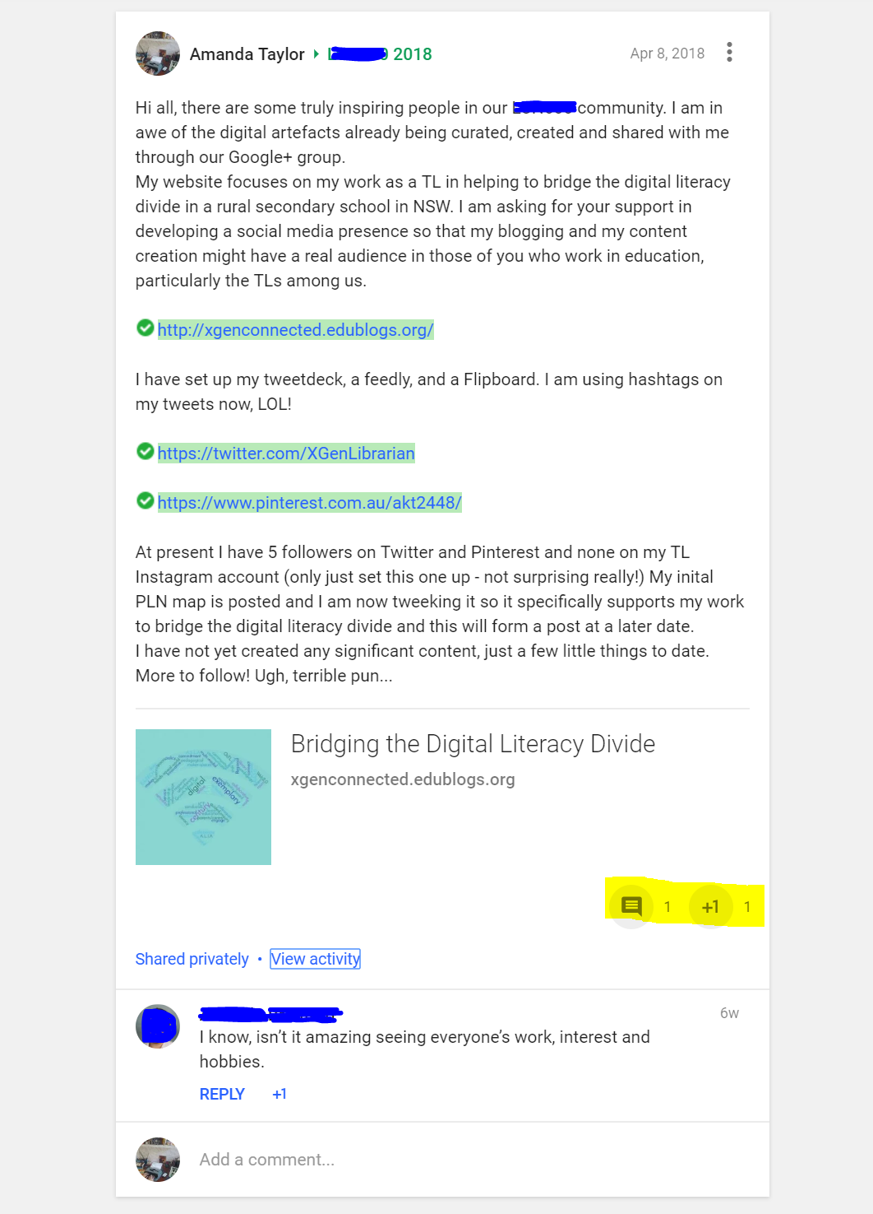
Another post to my Google+ community formed by University colleagues
This post to my community of peers contains the hyperlink to my website. It received one +1 and only a single comment. The link was investigated by another one of my peers but she declined to post a comment directly on my website. Her feedback through our G+ community advising me of a link error to my Flipboard magazine meant I could amend this without detriment to my site’s overall presentation. I am highly appreciative of this constructive criticism made available through my connected learning relationships (Nussbaum-Beach & Hall, 2012, p. 18).
08/04/18

Slide 5
My post to the google+ group ‘google for education’
08/04/2018
My sharing of my Powtoon to promote my website and its link was met with a deafening silence from the G+ Google for Education community. This aspect of my PLN has far looser connections and, critically, this ‘set’ has less affinity with my created content (Dron & Anderson, 2014, p.89). As a critical incident, its effect is to make me re-consider my audience.

Slide 6
Connecting to bloggers
In posting comments on sites created by renowned ‘connected educators’, I am seeking interaction with possible mentors to develop meaningful collaboration and authentic collegiality in my PLN (Nussbaum-Beach & Hall, 2012, p. 10).

Slide 7
Connecting with bloggers with an educational technology focus – Laura randazzo
At this time there remains no reply, it is a one way connection in my PLN. I will make use of this site for the construction of knowledge without the benefit of feedback and interactions that Baker-Doyle (2017, p.33) defines as participatory.
02/04/2018

Slide 8
Looking for Digital literacy mentors from across the globe: Phi delta kappan
12/04/2018
My comment is approved and is visible at the base of this very useful article on a new approach to teaching digital literacy by Phi Delta Kappan. This node is a weak tie in my PLN (Siemens, 2005). With time, and further action on my behalf, I hope that positive two-way interactions become feasible and that this asynchronous communication might augment my one-to-many interactions (Kalisz, 2016, p.56). My transparency and links to my own open educational resource are essential steps toward becoming a connected educator (Lupton, Oddone, & Dreamson, in press 2018).

Slide 9
twitter
Developing this powerful tool to curate, connect, and communicate was fundamental to my PLN. It is where most educators start building their networks (Richardson & Mancabelli, 2011, p. 40)

Slide 10
Building & curating a tweet deck for my topic
This social aggregation tool helps to manage the flow of tweets into various topics (Richardson & Mancabelli, 2011, p. 43).
07/04/2018

Slide 11
Revamping my professional twitter account
08/04/2018
At this point I am re-assessing who to follow and considering how to organically grow my 5 followers. I am building an intelligent stream of tweets that reflect my professionalism and my interest in the topic of digital literacy (Tour, 2017).

Slide 12
refining tweet deck with # hashtags
Twitter’s hashtags provide a powerful means of clustering around a single topic to create a social form of learning known as a set in my PLN (Dron & Anderson, 2014, p. 79)
05/05/2018

Slide 13
Posting intelligently to twitter
Using hashtags to label and categorise my tweet as this can be a powerful tool to promote discussion (Richardson & Mancabelli, 2011, pp. 44-45).
08/04/2018

Slide 14
Tweeting intelligently! commenting & replying to others’ tweets
12/04/2018

Slide 15
Building confidence and Tweeting to…
@IWBNet - australia
@coolcatteacher - USA
17/05/2018
14/05/2018
Personalising my tweets using the @ symbol.

Slide 16
Retweeted!
A critical incident occurs when @IWBNet retweets me and shares my website and my post on ‘building the digital literacy divide, a teacher-librarian’s perspective’. My contributions are gradually augmenting my reputation and my professional learning is at an exploratory level (Oddone, 2018).
18/05/18

Slide 17
facebook
Re-assessing Facebook as a professional tool to connect with peers and innovative professional educators, I now see it is a means to inform my professional learning and to share resources across my PLN (Richardson & Mancabelli, 2011).

Slide 18
Connecting with my closed Facebook group from University – Another critical incident
They replied!
08/04/2018
At this stage of my connected learning experience, greatest interaction occurs from within the ‘close ties’ of my PLN (Siemens, 2005). The link to my website was seen by 140 Facebook users, liked by 13 and commented on by two from within this social media node.

Slide 19
Connecting with my work colleagues via a closed facebook group
09/04/2018
I was hoping that this post might augment my followers and begin some pedagogical discussions. It became a critical incident because there was little response within my own peer community. It received 5 likes, but provoked no conversations. Perhaps it is because I am the only TL in this subset of 28 educators. Further action is required in this node.

Slide 20
Connecting with emails
Networking the old fashioned way …

Slide 21
Networking face-2-face at a teacher-librarian conference [mantle]
I emailed a colleague who presented a workshop at this conference.
12/05/18

Slide 22
The result of my email
I felt terrific that my resources will find an authentic audience. It is a critical incident on my connected learning journey and revitalises my value adding to my PLN! This positive reply and the sharing of my resources contributes to my professional digital identity and takes me one step closer to becoming a connected educator (Lupton, Oddone, & Dreamson, in press 2018).
12/05/18

Slide 23
Emails within the yammer tl community
Connecting with professional colleagues within the Department of Education.
12/05/2018

Slide 24
Another critical incident - 8 Replies from the Yammer TL community!
12-15 May, 2018
Positive interactions through sharing resources occurs due to closer ties in a smaller community of practice where there is professional affinity. This node’s interactions are yet to develop meaningful discourse. It is from within this CoP that I may find my ‘tribe’ - collaborative partners with a shared interest to bridge the digital literacy divide for our students (Dron & Anderson, 2014, p.80).

Slide 25
Bringing connections together
A critical incident: a comment on a blogsite leads to an email, this leads to an invitation, a discount to a conference, and a Twitter follower for my account that has 2400 contacts!

Slide 26
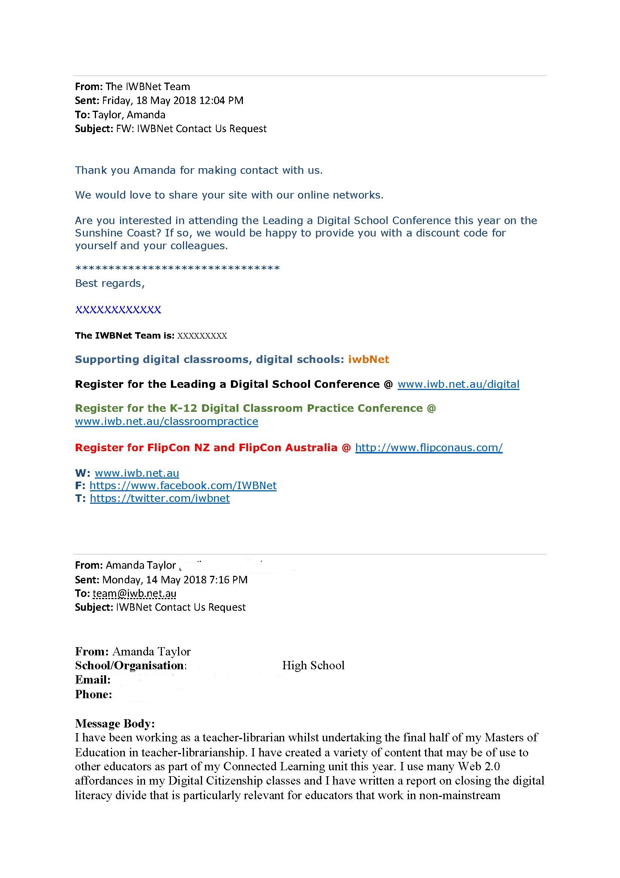
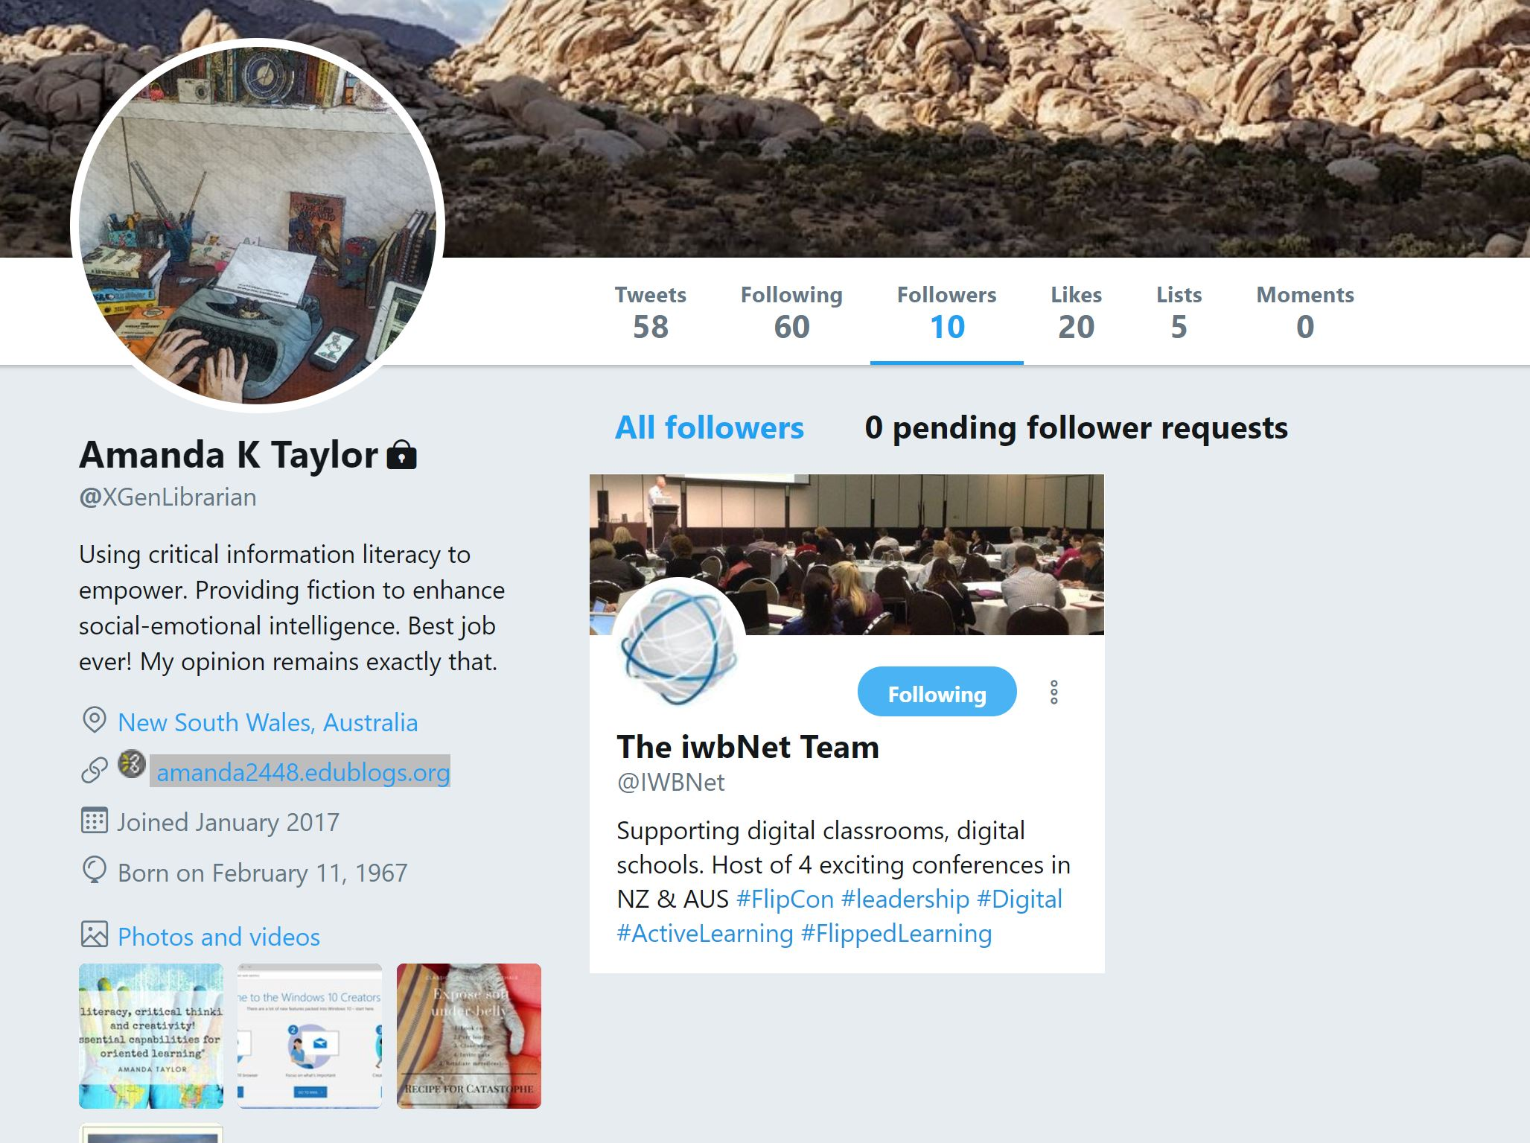
A blog comment, an email reply, & tweet success! This critical incident may transform ‘weak ties’ to ‘stronger ties’ within my PLN (Siemens, 2005).
18/05/2018

Slide 27
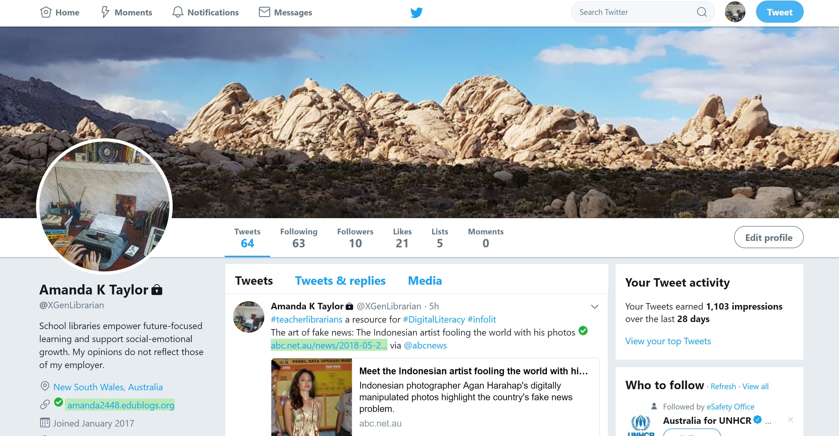
To date: My twitter account in may 2018
64 tweets, and still tweeting
Following 60+ professionals or educational organisations to inform my PLN
Growing my total ‘likes’
Adding to my followers, 5 have now grown to 10!
Curating critically [5 lists]
Polishing my digital identity profile with my professional blurb!
29th May 2018, an oversight has caused a critical incident! I realised I had protected my tweets. I have unlocked this to now make my tweets public. I had been overly cautious when I first joined Twitter in January 2017.

Slide 28
In conclusion
Connections form organically across social media and the digitally mediated communications ecology through thoughtful comments and transparent, open sharing (Morrison, 2016). I am learning to meter my time online and to act as a participatory digital citizen, to interact positively and readily with others, and to build my PLN mindfully and critically in working to become a connected educator .
Created by A. Taylor, 2018. CC by SA 2.0

Slide 29
references
Baker-Doyle, K. J. (2017). Chapter 3: Transformative teachers: Practices and profiles. In K. J. Baker-Doyle (Ed.), Transformative teachers; teacher leadership and learning in a connected world (pp. 31-66). Cambridge, Massachusetts: Harvard Education Press.
Dron, J., & Anderson, T. (2014). Teaching Crowds: Learning and Social Media. Athabasca: Athabasca University Press.
Kalisz, D. E. (2016). Crowd Learning: Innovative Harnessing the Knowledge and Potential of People. In L. N. E. S. Tiwari (Ed.), Innovative Management Education Pedagogies for Preparing Next-Generation Leaders (pp. 55-74). IGI Global: Hershey, PA. doi: 0.4018/978-1-4666-9691-4.ch004
Lupton, M., Oddone, K., & Dreamson, N. (in press 2018). Students' professional digital identities. In R. S. Bridgstock & N. Tippett (Eds.), Higher Education and the Future of Graduate Employability: A Connectedness Learning Approach. London, UK: Edward Elgar.
Morrison, D. (2016, June 3). 3 Takeaways from "What Connected Educators do Differently" [Web log post]. Retrieved from https://onlinelearninginsights.wordpress.com/2016/06/01/3-takeaways-from-what-connected-educators-do-differently/

Slide 30
references
Nussbaum-Beach, S., & Hall, L. R. (2012). Chapter 1: Defining the connected educator. In S. Nussbaum-Beach & L. R. Hall (Eds.), The connected educator: Learning and leading in a digital age (pp. 9-22). Bloomington, IN: Solution Tree Press.
Oddone, K. (2018). Transforming professional learning through Personal Learning Networks. In. [PowerPoint slides]. Retrieved from http://www.linkinglearning.com.au/networked-learning-conference-presentation-transforming-professional-learning-through-personal-learning-networks/
Richardson, W., & Mancabelli, R. (2011). Chapter 2: Becoming a networked learner. In W. Richardson & R. Mancabelli (Eds.), Personal learning networks: Using the power of connections to transform education (pp. 33-57). Moorabbin, Victoria: Hawker Brownlow.
Siemens, G. (2005). Connectivism: A learning theory for the digital age. International Journal of Instructional Technology and Distance Learning (ITDL), 2 (1). Retrieved from http://www.itdl.org/journal/jan_05/article01.htm
Tour, E. (2017). Teachers’ self-initiated professional learning through Personal Learning Networks. Technology, Pedagogy and Education, 26 (2), 179-192. doi: 10.1080/1475939X.2016.1196236

